Slide 1
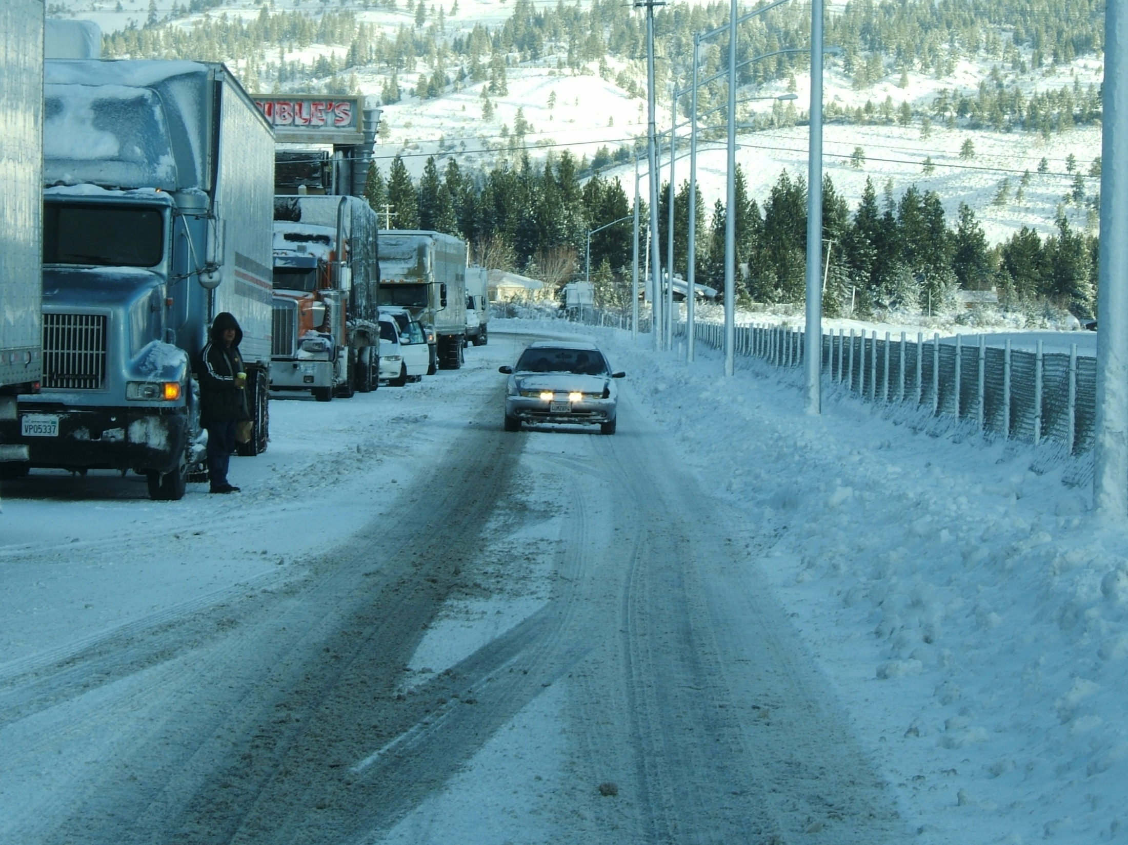
TRAVELER INFORMATION

Slide 2
511 Meeting
Feedback & Discussion
How is your state addressing freight needs via Traveler Information?
Available truck parking (public/private)
Advance notice of road restrictions/closures
Coordinate or share information with other states
Freight-specific menu selections or web pages in 511

Slide 3
WINTER OPERATIONS COALITION
Multi-State Approach to Improved Corridor Operations
Notes:
Formed between the partnering states to discuss and improve corridor operations along I-80.
Primarily from a winter perspective

Slide 4
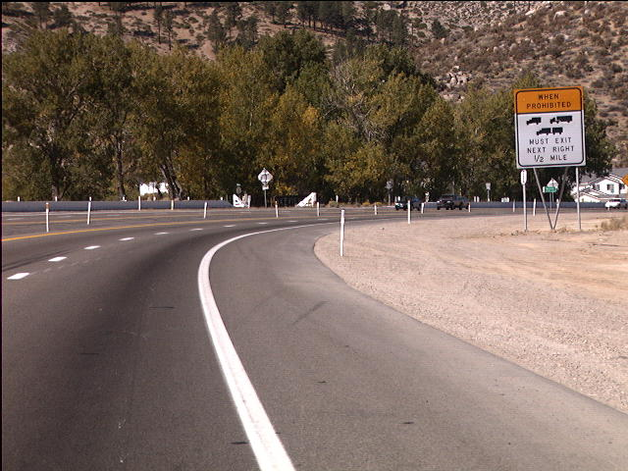
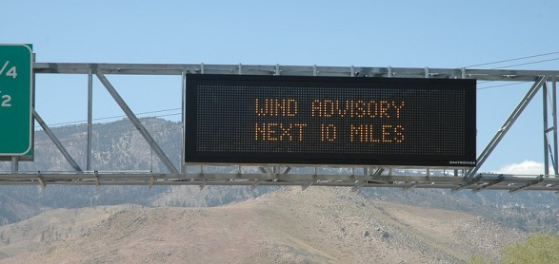
High Profile Vehicle Restrictions
Prohibit specific vehicles when sustained wind speeds and wind gusts exceed certain levels
Notification via DMS, 511 website & phone line, HAR and subscription text and/or email messages
Notes:
Currently in place on US 395 between Reno & Carson City. Similar restrictions will be put in place when the Hoover Dam Bridge opens in October on US 93 between Arizona and Nevada.

Slide 5
Nevada’s HAR system is automatically populated by 511 information
Notes:
NDOT has HAR equipment placed at critical locations throughout the state. Parameters have been set up to provide information relevant to a traveler in that area. Based on this criteria, relevant 511 information is automatically pushed out to each HAR site.

Slide 6
Wireless Internet Service
Service available at key rest stops & Welcome Centers along I-15 & I-80
Access to a traveler information website created by vendor, Scientel Wireless
Links to information regarding road conditions, weather, trucking, tourist information, etc.
Notes:
NDOT’s over dimensional permitting office would like an automated system that combines truck restrictions into 511, similar to that in Idaho.

Slide 7
State Feedback
Kansas
I-70 high freight route
Post vertical length, speed info coordinate weather & emergency info
Belong to Heartland States Coalition, which is looking into freight issues
511 has a CVO menu option…transfers to Permit office to provide restriction info, want to expand info
Idaho
CVO info on website
Menu option on phone
Focused on size/weight restrictions, spring thaw info, reduced speed requirements, escape ramp locations
Northwest Passage member
Pennsylvania
Various levels of vehicle restrictions
Pre-emptive closures
Share info with other states via TMCs
Struggling with getting info out
Partnering with local Motor Carrier Association
511 awareness via floodgates
Truck parking – pilot project via grant to post avail spaces via DMS
SACOG
Looking to add in localized truck routing, brake check areas and truck ramp occupancy on website

Slide 8
State Feedback, Cont’d.
Northern California
Email notification to Truck Motor Carrier Association and they send out (24/7) to 750 dispatch terminals
Special Alerts – calls for specific lane closures and timelines
Georgia
I-95 Corridor Coalition
Hub for STIX (Southern Traffic Information Exchange)
Exchanging information across state lines
Manual process up to now….will be automated with new Navigator system
San Diego
Local research on trucking
Separate webpage for CVO: border crossing info & road restrictions
System to launch within October/November
New York
Generic info on website but working to provide all CVO data
Trying to address bridge heights: HUGE number of bridges hit every month
They are extracting restriction info and passing it on to GPS companies (Navteq, TeleAtlas, Rand McNally) to be included in their systems….results in reduction in bridge hits!

Slide 9
State Feedback, Cont’d.
New Jersey
Working on automated permitting system, eventually want to be part of 511
24/7 contact to notify permittees of accidents/incidents
Arizona
Combined permitting/511 system
Spanish capabilities via web & phone
Include MP info to benefit truckers (Kansas & Idaho do too)
Wisconsin
Found you don’t need to necessarily tailor website to truckers needs….just need to get info out
3 groups, each is unique, so you need to work with all 3 to get whole picture
American Truck Association State Chapter
American Independent Truck Association
Independent Owners/Operators (don’t belong to any group or association)
Todd from NY also suggested contacting the National Association of Truck Stop Owners for a different perspective
511 Coalition will be doing a technical paper on CVO & Traveler Information to formally document what many states are doing.

Slide 10
Revenue Generation
Revenue generation for 511 system owners keeps you in control (Georgia Model)
You own the relationship with advertisers/sponsors
If you have the authority to receive funds, you generate revenue to pay for your system, enhancements, data, marketing
You maintain control of your system
You maintain control of your Right of Way
Your transparent approach creates public goodwill and maximizes revenue
Revenue Neutral (zero or low cost) for 511 system owners (Massachusetts Model)
You grant authority to a 511 system developer to generate revenue

Slide 11
Georgia-NaviGAtor.com
200,000 visits per month
#1 Google search for “Georgia Traffic”
Ads on every page
Sourced directly by sponsors and Google
Google revenue based on ad click-throughs
New website Nov 2010
10

Slide 12
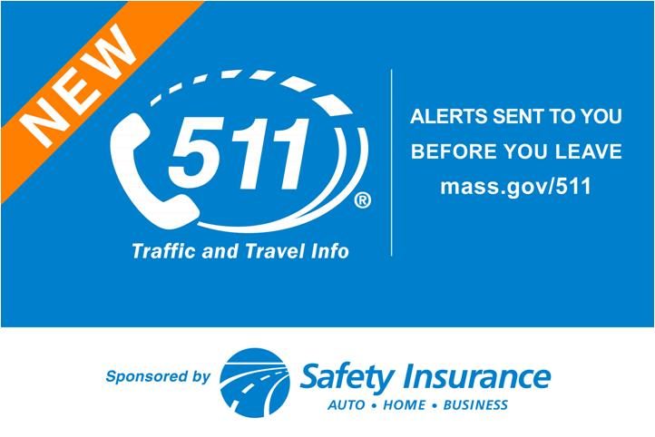
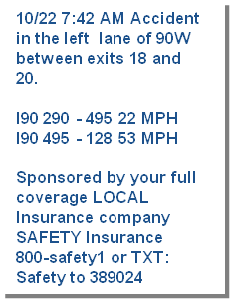
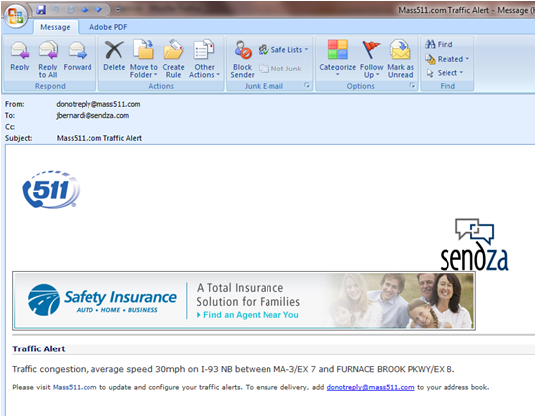
Massachusetts/Sendza Ad Examples
Roadway Signs
Toll Booth Signs
Text Alerts
Email Alerts

Slide 13
FHWA Says Revenue from Special Signs Must Support the Sponsored Program (Safety Patrols or 511)
Maximize Revenue by Establishing Rates Based on DEC—Daily Effective Circulation—the Method Used by the Outdoor Advertising Industry
Based on the annual average daily traffic (AADT) count of a location taking into account the average number of persons 18 and over in each vehicle, the visible traffic flow and the hours of illumination of the display.

Slide 14
Established Advertising Industry Average Rates Shown in Cost Per Thousand (CPM) Source: Traffic Audit Bureau

Slide 15
Thank You!
Denise M. Inda, P.E.
Asst. Chief Operations Engineer
Nevada DOT
775-888-7867
dinda@dot.state.nv.us

